Slide 1
Project Plan
Research Portal Team
Team Members:
Bijaya Sharma
Priyal Patel
Madhavi Thakur
Rabindra Budhathoki
Nitu Singh
Michelle Brown

Slide 2
Project Overview
The North Carolina Central University research portal is designed to research and research related community engagement. The NCCU Division of Research and Sponsored Programs would like to develop a database driven web portal to share information about all research at NCCU. The six team members of research portal are committed to develop a research portal to provide the end user access to the multiple research and research related community engagement projects through a web-based application. The team will implement a solution using Drupal to integrate with the new NCCU website and platform.

Slide 3
Scope
The NCCU research portal project will explore how the users can access the research related activities campus-wide for strengthening and enhancing the University's academic programs.
The research portal will help to find information for research and explore to users and it also helps to provide campus leaders management reports and ad hoc queries for use in campus reports, research proposals and so on.

Slide 4
Goals
The goal of the NCCU research portal is to support the Division’s mission to provide the leadership for strengthening and enhancing the University's academic programs through campus-wide research and economic development initiatives.
It will provide the various research related information through a web-based application to the end users in campus-wide.
The research portal will serve as the gateway to an up-to-date and reliable database of information about research activities, including research related community and public engagement activities at NCCU.

Slide 5
Milestones and Deliverables
Key Milestones | Start Date | Deliverables End Date
Client Meeting | Monday, September 10, 2018 | Monday, December 12, 2018
Project Kick Off Meeting | Saturday, September 22, 2018 | Monday, October 8, 2018
Team Contract | Thursday, September 27,2018 | Saturday, September 29,2018
Business Requirement Gathering | Wednesday, September 26, 2018 | Saturday, October 20, 2018
Prototype Demo | Friday, October 5, 2018 | Monday, October 22, 2018
Project Implementation | Monday, October 22, 2018 | Friday, November 30, 2018
Unit and System Integration Testing | Monday, November 19 | Friday, November 23, 2018
User Acceptance Testing / Product Readiness Testing | Tuesday, November 13, 2018 | Friday November 30, 2018
Release - Go live | Monday December 03, 2018 | Monday, December 03, 2018

Slide 6
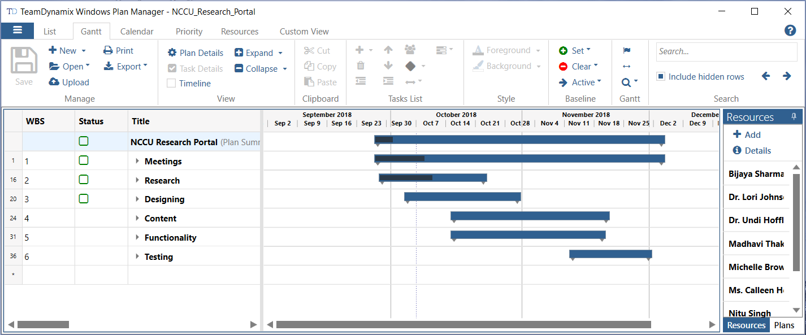
Work Breakdown Structure

Slide 7
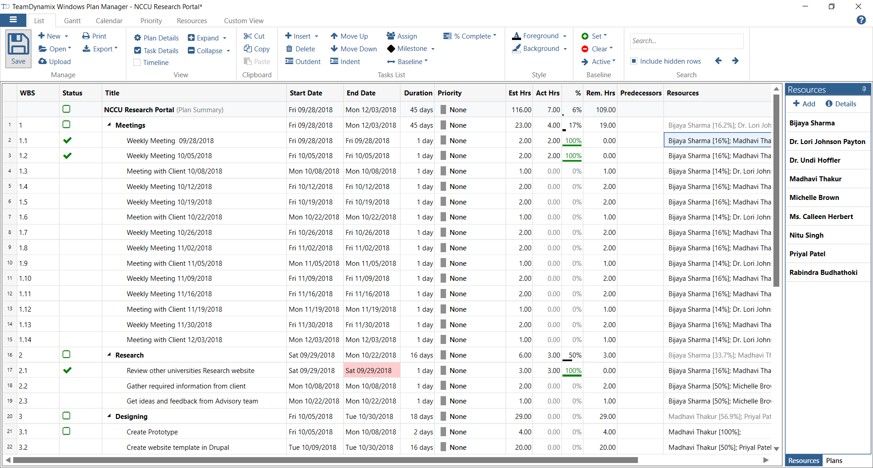

Slide 8
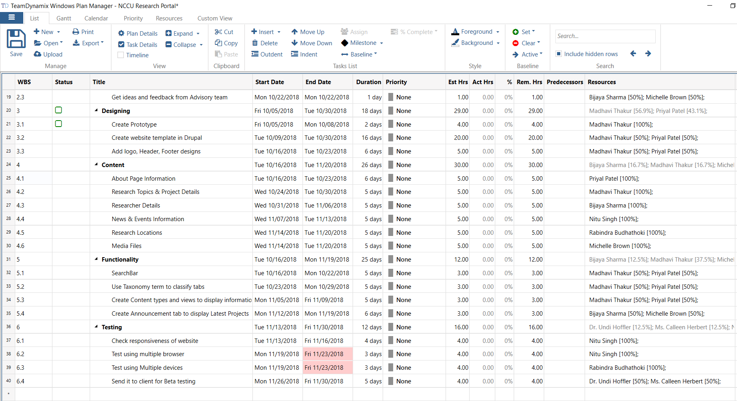

Slide 9
Communications Plan
Stakeholders | Document/ Message | Format | Communicator | Delivery Frequency
Project Sponsor | Project plan, status report | Meeting, Intranet | Project Manager | Weekly/Biweekly
Team Members | Project Status Report | Meeting, Intranet | Project Manager | Weekly
Management Supervisor | Project Status Report | Hard/Soft Copy | Project Manager | Once a month
User group | Project Status Report | Hard/Soft copy | Project Manager | Weekly/Biweekly
Internal IT Staff/Manager | Project Status Report, Briefing | E-mail, Hard/Soft copy | Project Manager | Biweekly/Quarterly

Slide 10
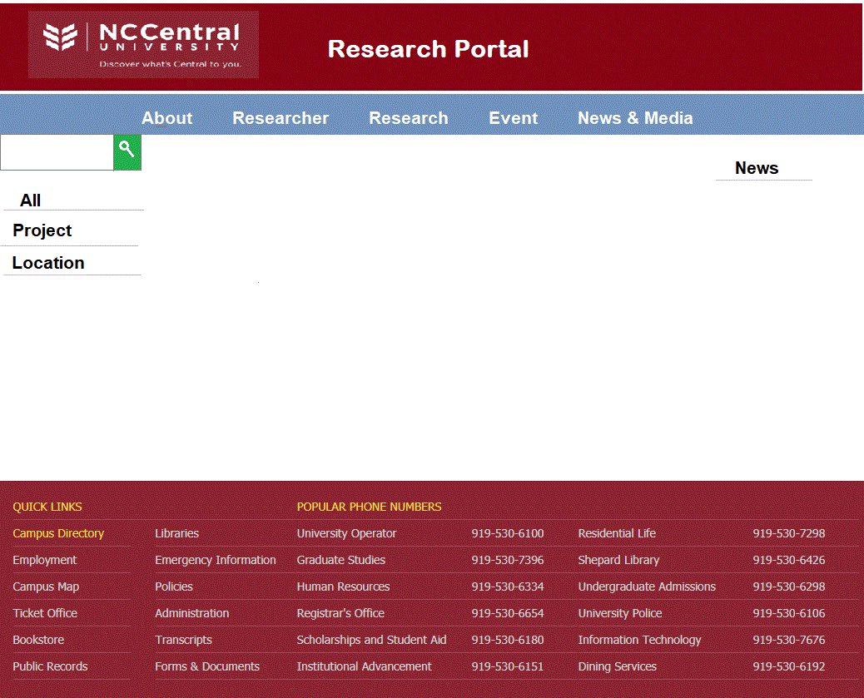
Design/ Prototypes
Notes:
This will be the Home page of NCCU Research Portal.

Slide 11
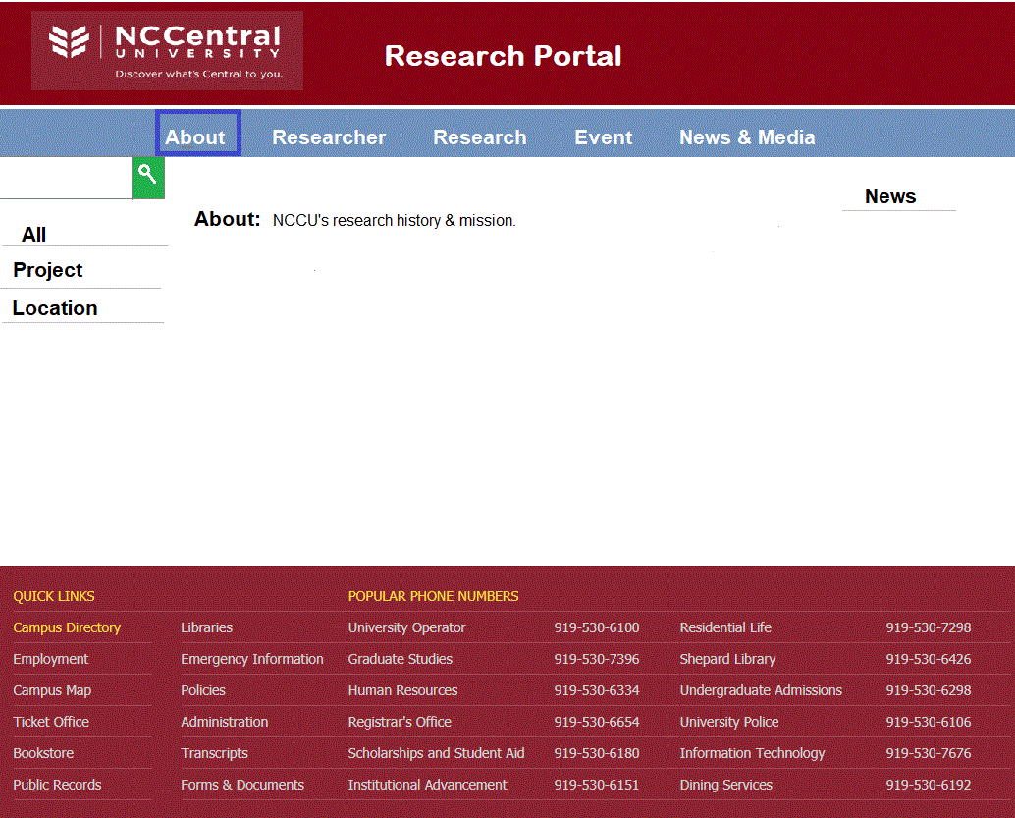

Slide 12
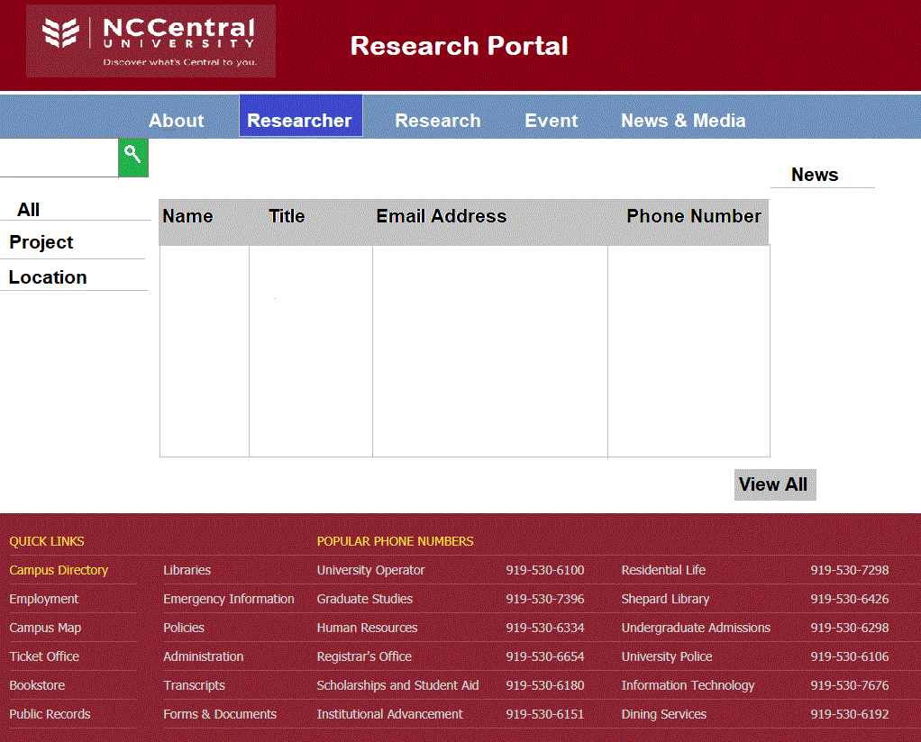

Slide 13
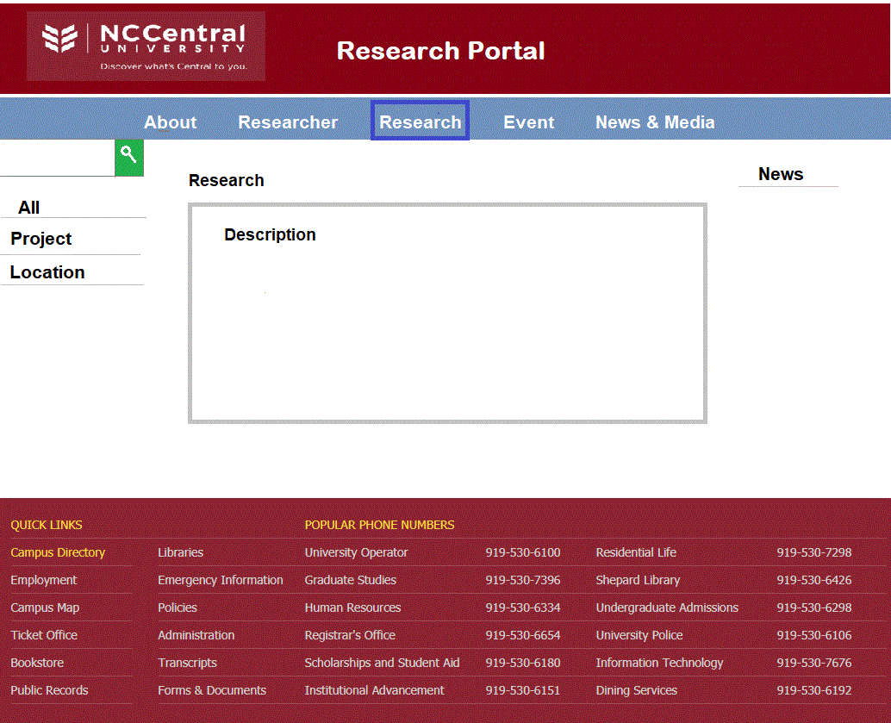

Slide 14
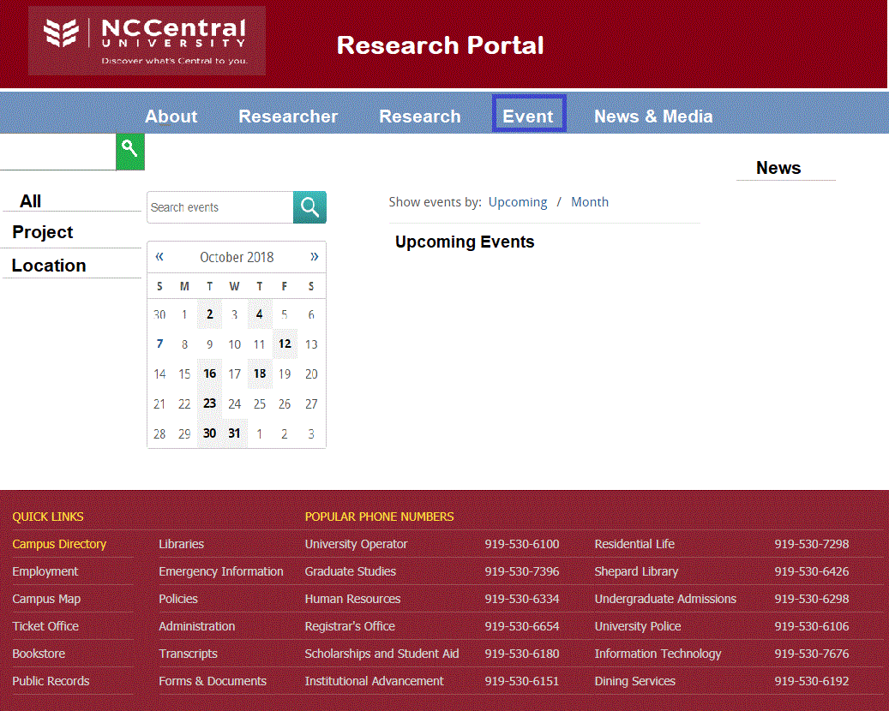

Slide 15
